Slide 1

Lacunes

Slide 2
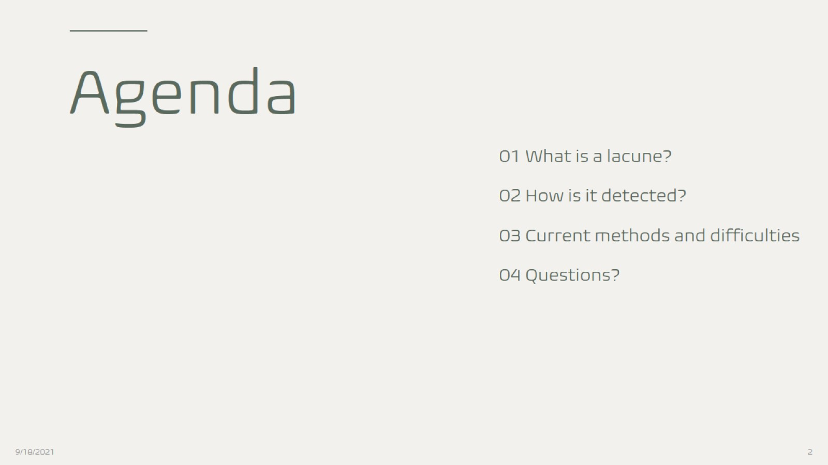
Agenda

Slide 3
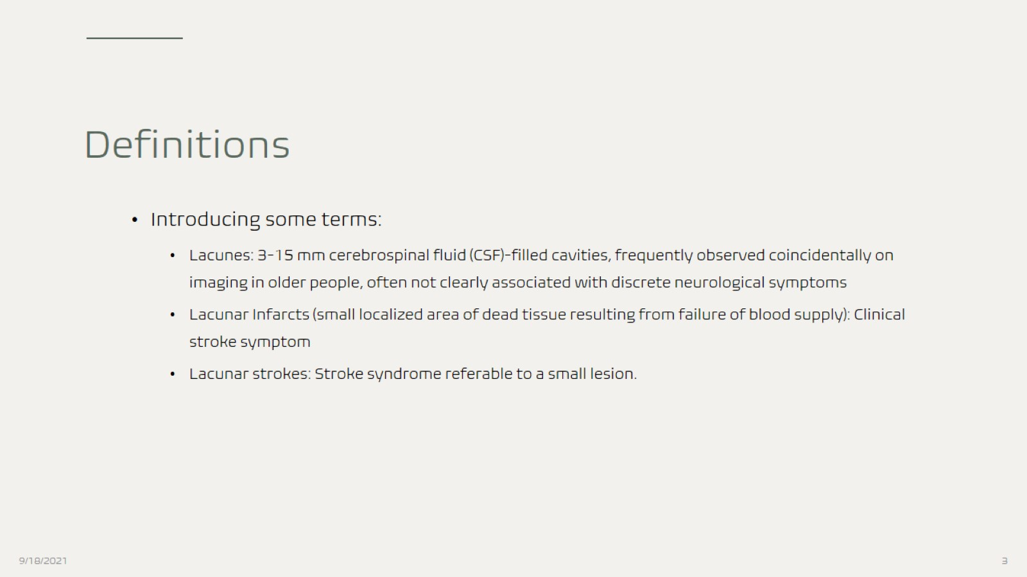
Definitions

Slide 4
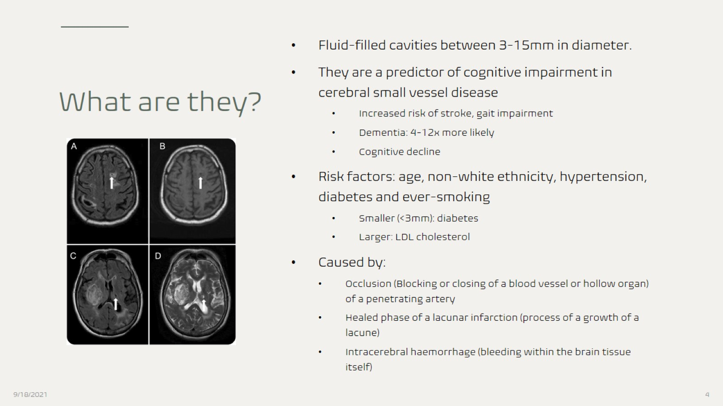
What are they?

Slide 5
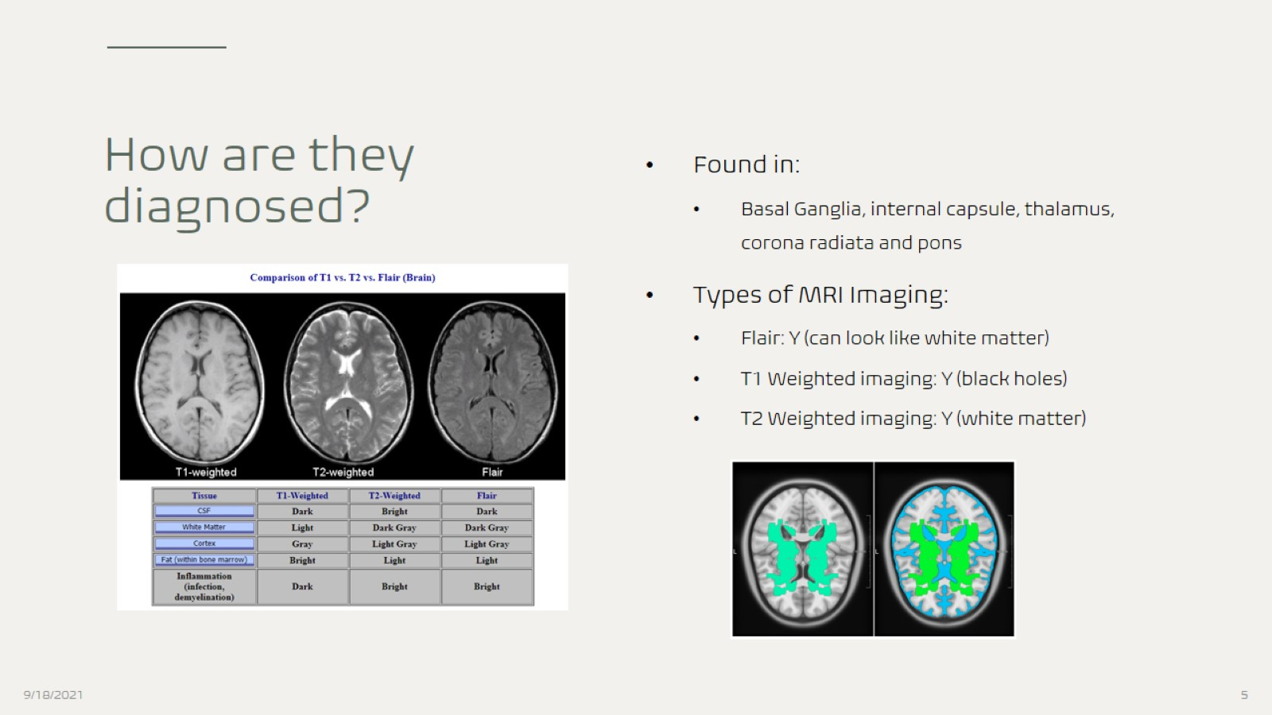
How are they diagnosed?

Slide 6
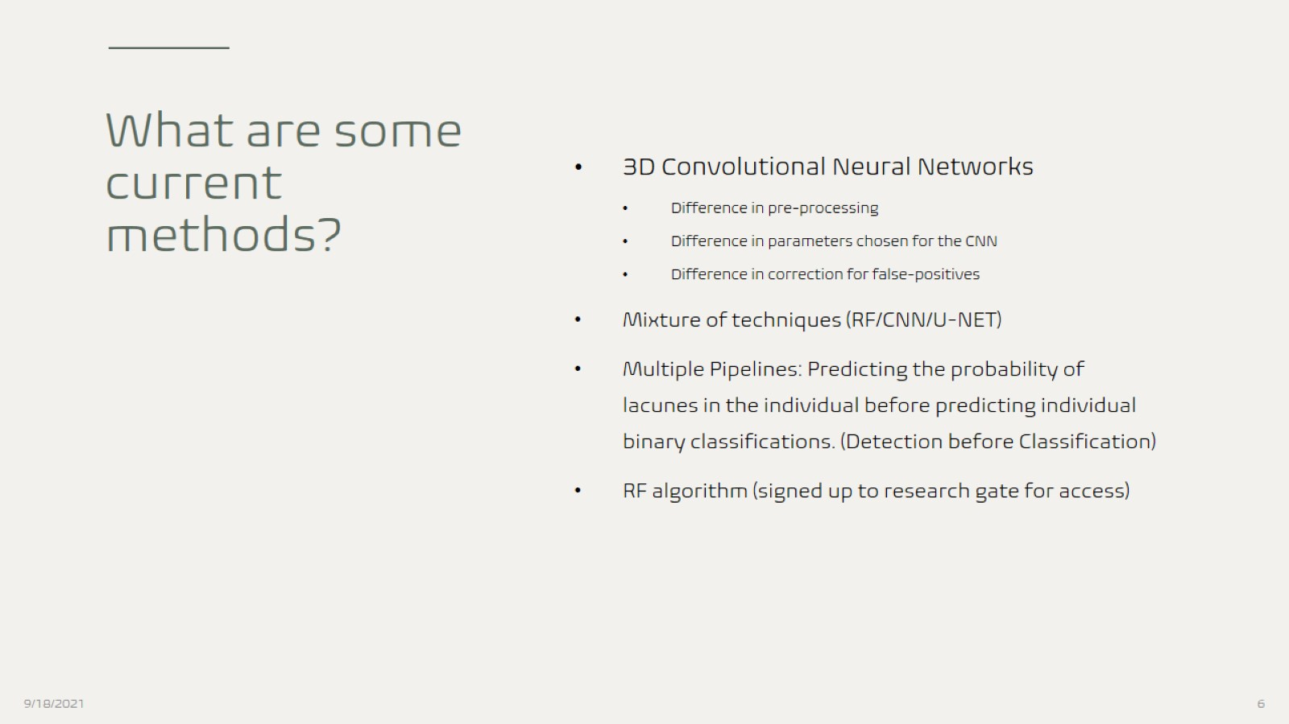
What are some current methods?

